Slide 1
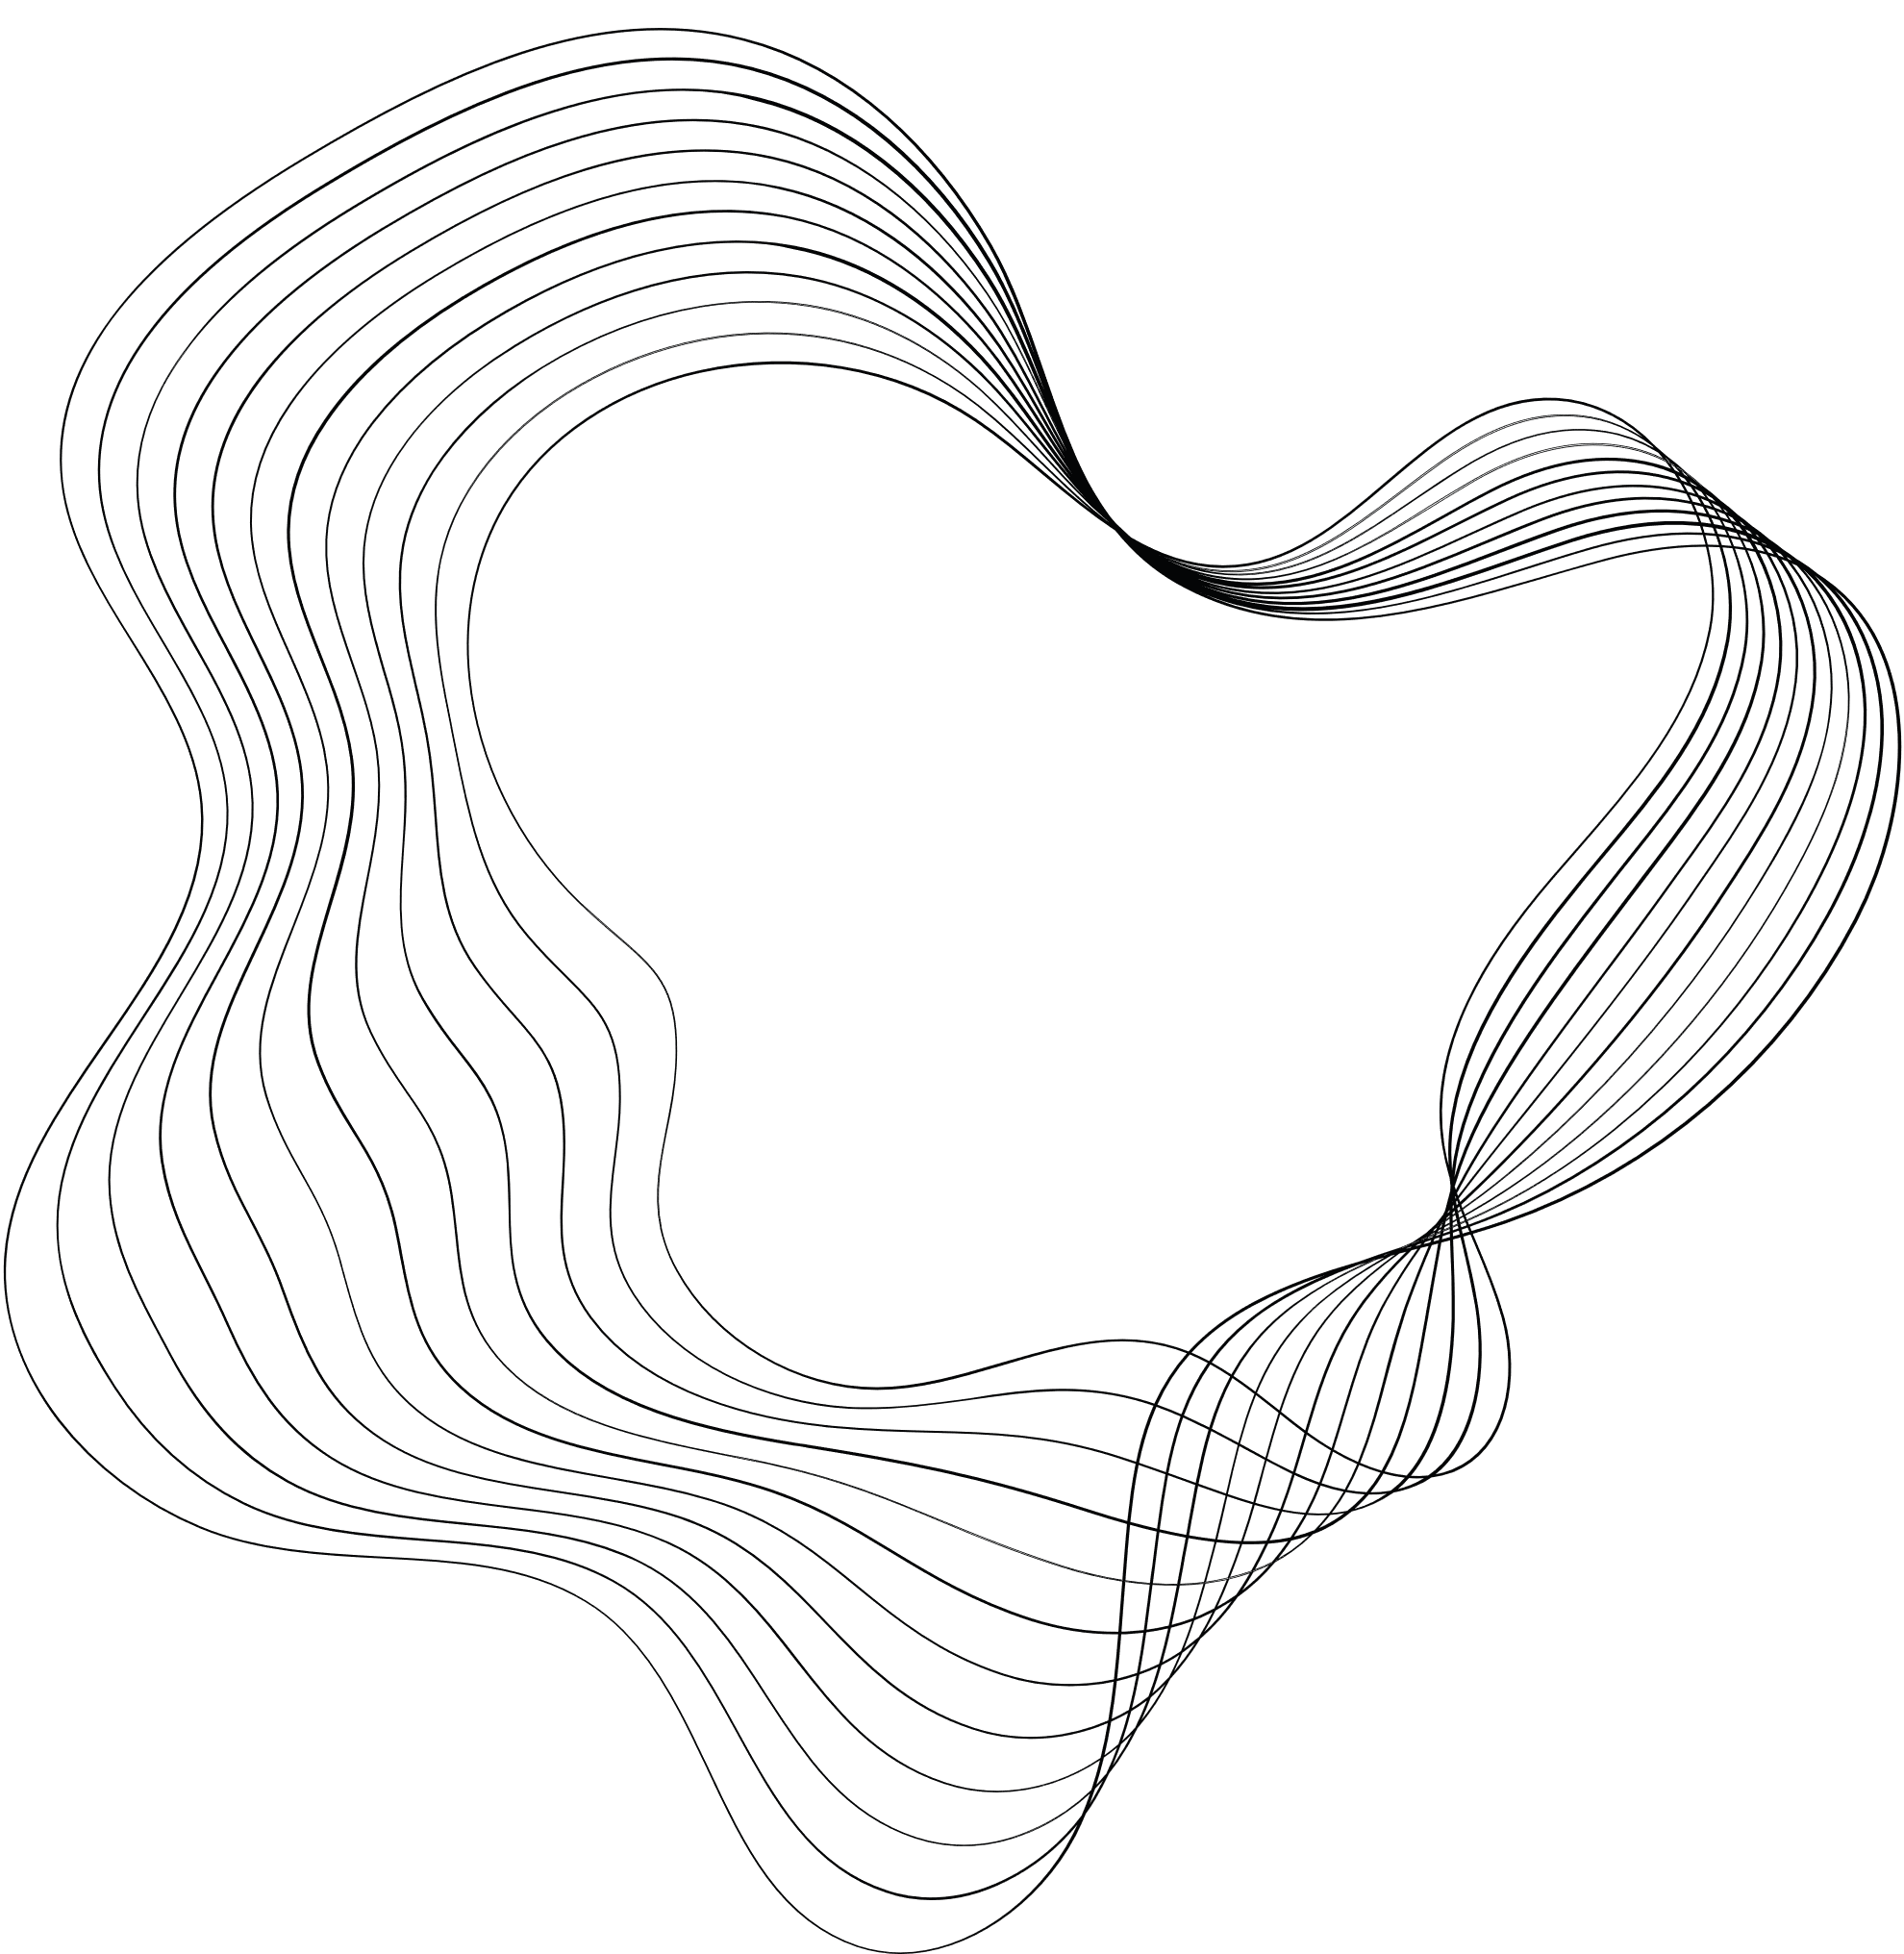

DNA Sequence Matching Using Automata on Hardware
BY
ROHITH . M ( 192210434)
Arish Kumaran G (192211064)

Slide 2
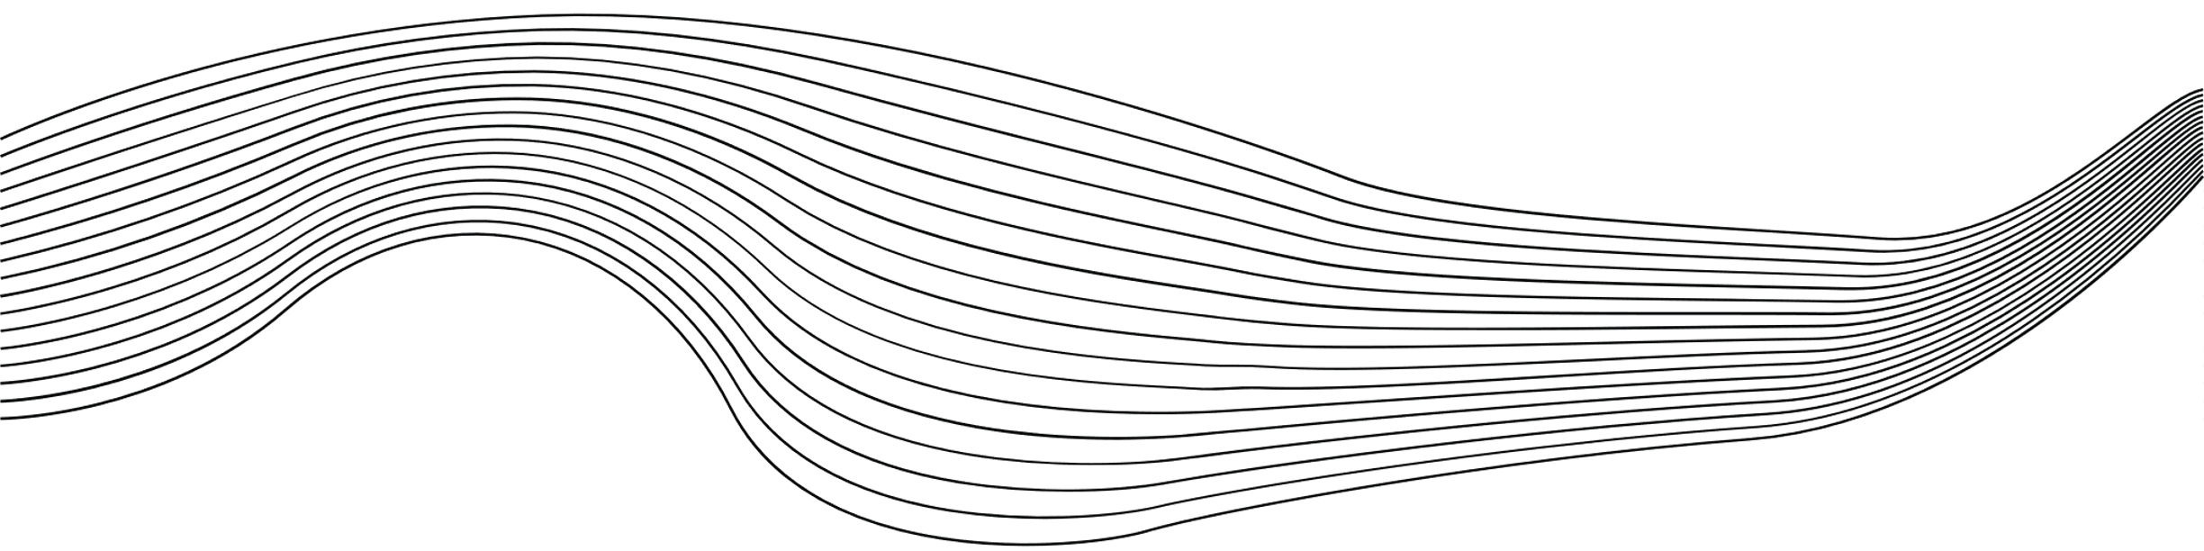
CONTENT
01
ABSTRACT
02
INTRODUCTION
03
METHODS AND MATERIALS
04
RESULTS AND DISCUSSION
05
CONCLUSION

Slide 3

ABSTRACT
DNA sequence matching is a fundamental task in bioinformatics, involving the identification of specific patterns or motifs within large DNA sequences. Traditional software-based methods for sequence alignment, such as BLAST and Smith-Waterman, are computationally intensive, especially when processing large datasets
The project demonstrates significant improvements in execution time due to the parallel processing capabilities of the FPGA, making this approach suitable for large-scale genomic data analysis and real-time bioinformatics applications.

Slide 4
INTRODUCTION
The process involves searching for specific patterns within long strands of DNA, which are composed of nucleotide bases represented by the letters A, T, C, and G. Given the vast amount of genomic data generated today, efficient and scalable methods for DNA sequence matching are increasingly critical.
. This project explores the use of finite automata theory to model DNA sequence matching and implements it in hardware using Field Programmable Gate Arrays (FPGAs). Automata, particularly Deterministic Finite Automata (DFA) and Non-Deterministic Finite Automata (NFA), are well-suited for pattern recognition tasks, including DNA sequence matching.

Slide 5

DNA SEQUENCE MATCHING
AUTOMATA THEORY AND DNA MATCHING
OBJECTIVE
FINITE AUTOMATA DESIGN
Model the DNA sequence matching problem using deterministic or non-deterministic finite automata.
Implement the automaton in hardware, taking advantage of FPGA parallelism to accelerate the matching process.
DNA sequences are long chains of nucleotides, and finding a specific sequence or pattern within a larger sequence is known as DNA sequence matching.
A transition table is created to define how the automaton moves from one state to another based on the input nucleotide. The table has rows corresponding to the current states and columns corresponding to the input nucleotides (A, T, C, G).
. A finite automaton is a simple machine with a finite number of states, and it processes an input string (in this case, a DNA sequence) by transitioning between states based on the input symbols (nucleotides A, T, C, and G).

Slide 6
METHODS AND MATERIALS
The automaton is designed to recognize a specific DNA sequence or pattern, and its operation is based on transitioning between states depending on the input nucleotide (A, T, C, G).
The FPGA is programmed using Hardware Description Languages (HDL), such as VHDL or Verilog, which describe the logic of the automaton and how it handles input sequences.
The simulation helps identify any issues in the state transitions or input handling, allowing us to fine-tune the design before hardware synthesis.
The simulation helps identify any issues in the state transitions or input handling, allowing us to fine-tune the design before hardware synthesis.

Slide 7
RESULTS AND
DISCUSSION
The results of implementing DNA sequence matching using automata on FPGA provide insights into the performance benefits of hardware-based solutions compared to traditional software-based methods, particularly for large-scale bioinformatics applications.
This section discusses the experimental outcomes, key performance metrics such as execution time, resource utilization, accuracy, and scalability, along with an analysis of the system's capabilities, limitations, and potential future improvements.

Slide 8
CONCLUSION
The implementation of DNA sequence matching using automata on hardware, specifically FPGA, offers a significant performance advantage over traditional software-based methods, such as BLAST. By leveraging the inherent parallelism of FPGA architectures, this approach reduces the time required to match DNA sequences, demonstrating speedup factors of up to 10x, especially for larger datasets. This makes it particularly well-suited for bioinformatics applications where high-throughput and large-scale genomic data processing are required.

Slide 9


THANK'S FOR WATCHING
ROHITH, INC.

